Slide 1

Data Imbalance Processing Based on Amazon Food Review
By: Ian Kamar,Youyang Zhou, Younhao Dou, Yi Ding, Hanqiu Xu.

Slide 2
1
Data
2
Methods
3
Conclusion

Slide 3
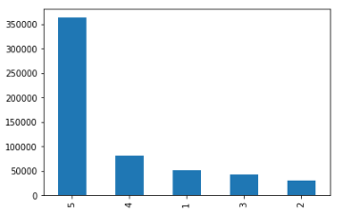
Data
Labels distribution raw data
New:1
New:0
5+4>>2+1
imbalance

Slide 4
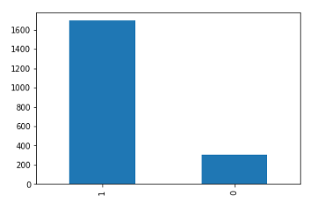
Data
The paper using data
1>>0
imbalance

Slide 5
Bag of words
Word Vector
Word
John likes to watch movies. Mary likes too
John also likes to watch football games.
dictionary
{"John": 1, "likes": 2, "to": 3, "watch": 4, "movies": 5, "also": 6, "football": 7, "games": 8, "Mary": 9, "too": 10}
vector
[1, 2, 1, 1, 1, 0, 0, 0, 1, 1]
[1, 1, 1, 1 ,0, 1, 1, 1, 0, 0]

Slide 6
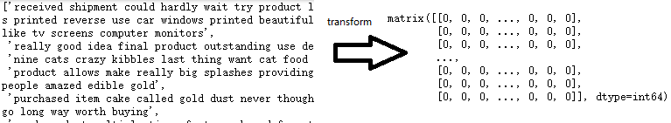
Word Vector
Reviews transform vector

Slide 7
Imbalanced Data
RandomOverSampler
SMOTE and
SMOTETomek.
Data
1998
Train
1598
Train
2720
0
307
1
1691
0
1360
1
238
0
1360
1
1360

Slide 8
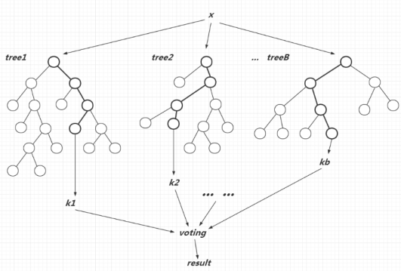
Random Forest

Slide 9
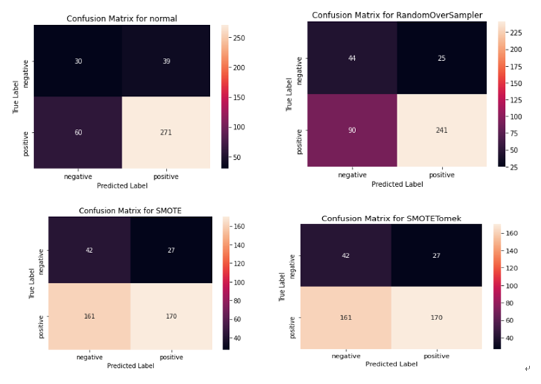
Results-confusion Matrix

Slide 10
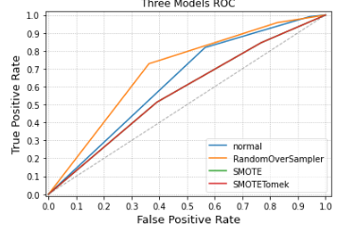
Results-ROC curve
normal
auc0.63 precision0.874 recall0.819
RandomOverSampler
auc0.693 precision0.906 recall0.728
SMOTE auc0.571 precision0.863 recall0.514 SMOTETomek
auc0.571 precision0.863 recall0.514
random sampling method is best

Slide 11
Conclusion
The two sampling methods are not good because of the possible sampling ratio and is a problem that we will consider in the future.

Slide 12
Reference
Data Source:
https://www.kaggle.com/snap/amazon-fine-food-reviews
https://github.com/krpiyush5/Amazon-Fine-Food-Review

